Slide 1

MACHINE LEARNING FINAL PROJECT
POWER GENERATION IN US

Slide 2
CONTENT
Problem statement
Data Description
Analysis
Conclusions
Summary

Slide 3
Problem Statement
The objective of Power plants is to give their customers affordable, dependable electricity while also having as little of an impact on the environment as possible.
Examining and clustering the PUDL dataset and finding out which cluster have highest Sulphur and ash emission.

Slide 4
Data Description
The dataset PUDL is extracted from massive dataset published by the US government which shows the fuel receipts.
The dataset consists of 20 attributes.
Looking through all variables and chosen all the numeric and characteristics variables.

Slide 5
Analysis
Implemented K- means to cluster and analyzed the usage and composition.
Data is divided into 5 clusters based on sulfur content, ash content and fuel units received.

Slide 6
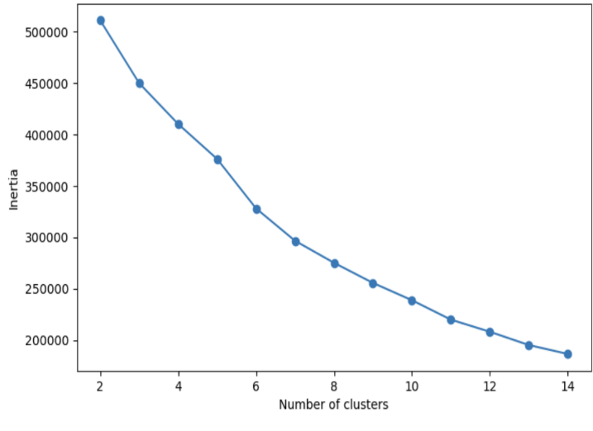
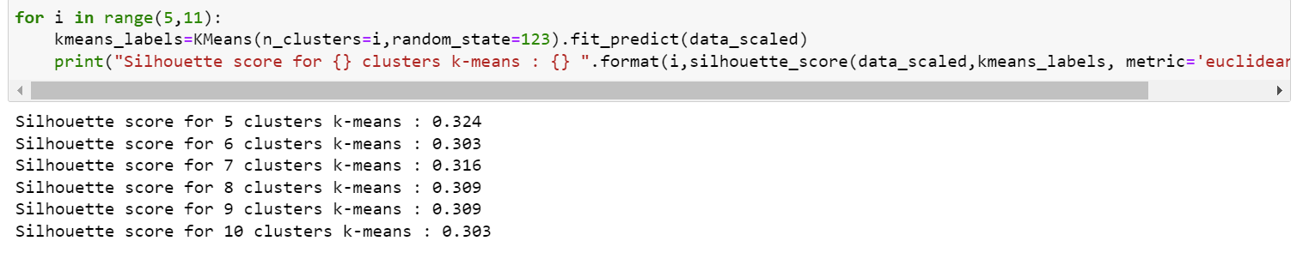
Wss Method Silhouette Method

Slide 7
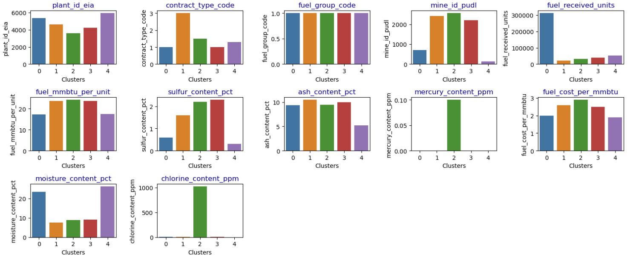
CLUSTER PLOTS

Slide 8
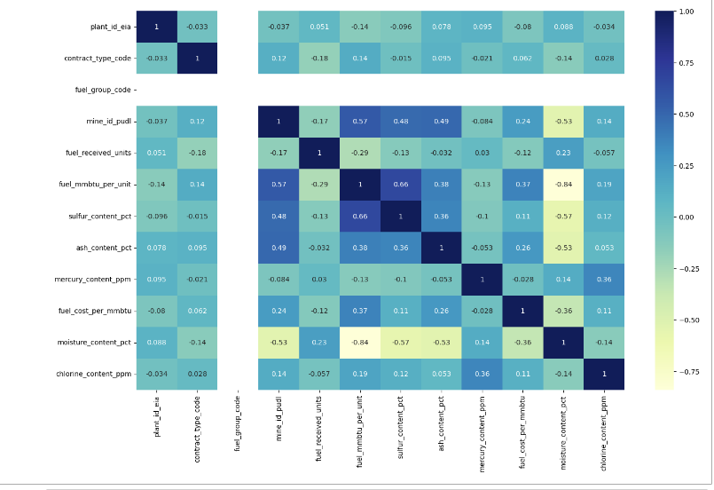
EFFICEINT | CLUSTER –
BALANCED | CLUSTER –
INEFFICIENT | CLUSTER –

Slide 9

CONCLUSION

Slide 10
THANK YOU

